Slide 1
Loan Eligibility Prediction Using Machine Learning
Monish Varghese Joshy
Data Science practicum 2
August 15, 2021

Slide 2
Index
Introduction
Dataset Information
Exploratory Data Analysis
Data Preprocessing
Feature Selection And PCA
Results
Software Libraries Used

Slide 3
Introduction
Loan Prediction is very helpful for employees of banks as well as for the applicant also.
The aim of this report is to provide a quick, immediate, and easy way to choose deserving applicants.
Dream housing Finance Company deals in all loans. They have a presence across all urban, semi-urban, and rural areas. Customer first applies for a loan after that company or bank validates the customer eligibility for the loan.
Company or bank wants to automate the loan eligibility process (real-time) based on customer details provided while filling the application form. These details are Gender, Marital Status, Education, Number of Dependents, Income, Loan Amount, Credit History, and others.
This project has taken the data of previous customers of various banks to whom on a set of parameters loans were approved. So the machine learning model is trained on that record to get accurate results.

Slide 4
Dataset Information
The dataset is originally provided by Dream Housing Finance company deals in all home loans. They have a presence across all urban, semi-urban, and rural areas. Customer-first applies for a home loan after that company validates the customer eligibility for a loan.
This dataset was taken from this link uploaded on Kaggle: https://www.kaggle.com/vikasukani/loan-eligible-dataset
The loan eligibility dataset consists of 614 rows and 13 features, which were further split into 8:1:1 ratio for train, val and test datasets.

Slide 5
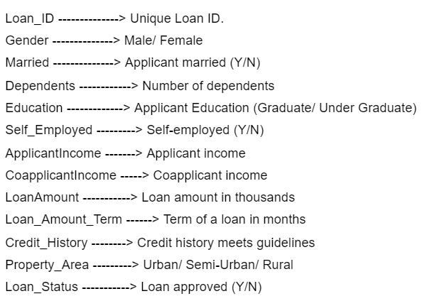
Exploratory Data Analysis
The following image gives a brief explanation about all
the features of the dataset:
The different features of the dataset are divided into three
different categories:
Categorical features: These features have categories
(Gender, Married, Self_Employed, Credit_History, and
Loan_Status)
Ordinal features: Variables in categorical features having some
order involved (Dependents, Education, Property_Area)
Numerical features: These features have numerical values (ApplicantIncome, Co-applicant income, LoanAmount, Loan_Amount_Term)

Slide 6
Exploratory Data Analysis (EDA)
The following points summarize the different observations in EDA (since the graphs and all are already included in report, they aren’t repeated here.)
80% of applicants in the dataset are male.
Around 65% of the applicants in the dataset are married.
Around 15% of applicants in the dataset are self-employed.
Around 85% of applicants have repaid their doubts.
Most of the applicants don't have any dependents.
Around 80% of the applicants are graduates.
40 percent of homes are in semi-urban areas
31 percent of homes are in urban areas
29 percent of homes are in rural areas
85 percent of accepted applications have a positive credit history
Rate of accepted applications 70 meaning that the data set is unbalanced

Slide 7
Data Preprocessing
Data preprocessing is a data mining technique which is used to transform the raw data in a useful and efficient format.
Filling Missing Data
There are very few missing values in Gender, Married, Dependents, Credit_History, and Self_Employed features so we can fill them using the mode value of the features.
Deterministic Regression Imputation - The null values of the two features “LoanAmount” and “Loan_Amount_Term” were filled using the values predicted by regression model, which is also called as regression based null values imputation.
Feature Encoding
The categorical features such as Gender, Married, Self_Employed, Credit_History, and Loan_Status were OneHot Encoded, and the ordinal categorical features such as Dependents, Education and Property area were Label Encoded. I have experimented with different types of feature encoding techniques in order to get the highest performing set of features.

Slide 8
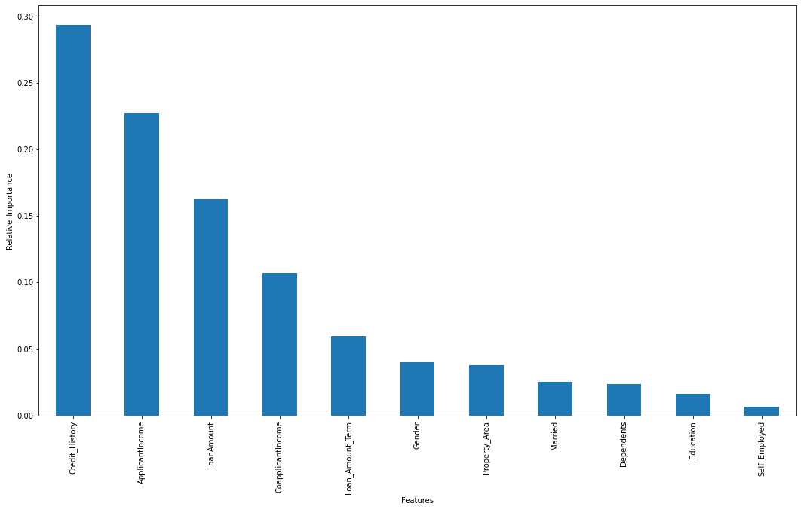
Feature Selection and PCA
Feature selection is one of the crucial processes in any Machine Learning project, in which we reduce the number of input features to the predictive model. This method has various different advantages.
I have selected the top eight features out of the eleven features by the help of this feature importance plot. The number of features used here are varied from a range of six to ten and the best performing set of features were selected for the final model training.
Following this, Principal Component Analysis (PCA) were performed on the features of the dataset in order to perform feature reduction. Principal component analysis (PCA) is a technique for reducing the dimensionality of such datasets, increasing interpretability but at the same time minimizing information loss. It does so by creating new uncorrelated variables that successively maximize variance.
Figure : Feature Importance Plot of different features of dataset

Slide 9
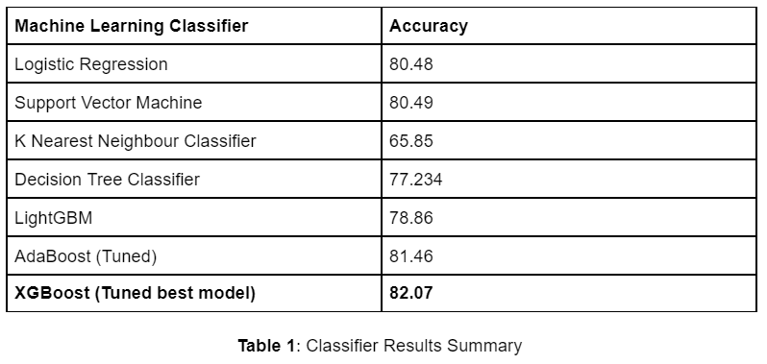
Results
We implemented various machine learning classifiers for baseline creation and finally selected XGBoost Classifier as the best model to be further used for hyper-parameter tuning. XGBoost is a scalable and accurate implementation of gradient boosting machines and it has proven to push the limits of computing power for boosted trees algorithms as it was built and developed for the sole purpose of model performance and computational speed.
We were finally able to achieve 82.073% accuracy in the final week of coding using XGBoost classifier. The following table gives a detailed results summary of different classifiers used in the baseline as well as the final model results.

Slide 10
Software Libraries Requirements
The following are a complete list of Python libraries required to replicate the code for this project:
Numpy
Pandas
Seaborn
Matplotlib
Plotly
Warnings
Scikit-learn
XGBoost
LightGBM
Math
Time
Mlxtend

